Slide 1


Developers
We provide software solution for
your every problem.
Team Members
Muhammad Fahad (FA19-BSSE-0014)
A project idea by FA developers

Slide 2
Background
This application is created because the owner want an application that can be easily accessible always on the users devices and it will also help user to make orders and also inform them about every single process from orders to deliveries, special offers and new arrivals. So that the person don’t have to visit the website everyday to see about their order, new offers and arrivals.
Wear unique, to be unique

Slide 3
The Appropriate Quality Model
I selected FURPS selected as the model of quality FURPS has following characteristics
Functionality: All the functionality of the application can be a part of quality model in FURPS.
URPS ( Non-functional Requirement)
Usability: The UI/UX experience can be made better in the FURPS quality model as it is focus.
Reliability: The application can be made to be more better responsive, and availability
Performance: The performance part focus on the better response of the application.
Supportability: The supportability increases the application maintainability and testability.

Slide 4
Why FURPS?
The reason to select the FURPS as the quality model for the application are following below:
The functionality of the application can be cover by the functionality part.
As we talk about non functionality requirement the e-commerce application need Usability, Reliability, Performance and Supportability cover most of the quality attribute the e-commerce website need.
As it cover most of the requirement to meet for the ecommerce application it can be a part of quality in every update because of the focus of the following attributes available in FURPS.

Slide 5
Cost of Quality
As the requirement are more clear we make sure to calculate the cost and appraisal cost is higher than other due to the reason there is more chances of bug fixing then the failures and other factors.
PC = Prevention Cost = 5000$
AC = Appraisal Cost = 10,000 $
IFC = Internal Failure Cost = 5000$
EFC = External Failure Cost = 5000$
Cost of Quality = P C + A C + IFC + EFC = 20,000$

Slide 6
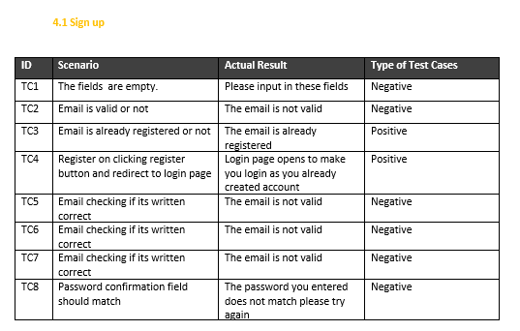
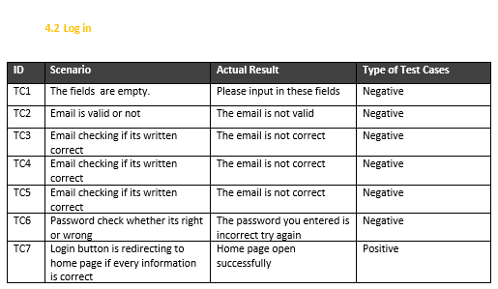
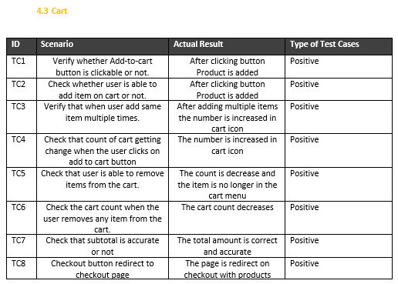
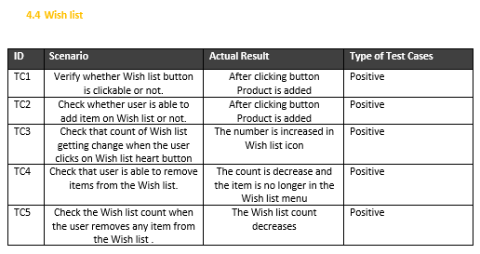
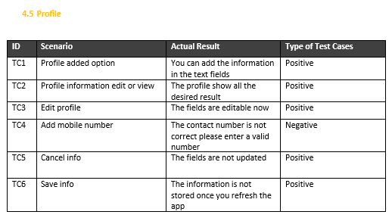
Functionalities

Slide 7

Thank You

